Slide 1

Object-Oriented Software Analysis & Design (COMP-3220) Lecture 5 Singleton Pattern
School of Computer Science
Faculty of Science
University of Windsor
Dr. Saeed Samet

Slide 2
Big Data Analytics and Database Design
Intent
The Singleton Pattern ensures that:
A class has only one instance and provides a global point of access to that instance.
In other words:
only one object of the class can exist throughout the application.

Slide 3
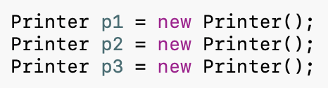

Big Data Analytics and Database Design
Motivation
Suppose you are developing an application that uses a printer.
Without restrictions:
Multiple printer manager objects may exist.
Problems:
Inconsistent printer settings
Resource conflicts
Wasted memory
Difficult synchronization
We want:
where: p1 == p2
is always true.
Singleton guarantees that only one instance exists.

Slide 4
Big Data Analytics and Database Design
Problems It Solves
Ensures a Single Instance
Some objects should exist only once.
Examples:
Printer manager
Configuration manager
Logging service
Database connection manager
Provides Global Access
Any part of the application can access the same instance.
Controls Shared Resources
Prevents multiple objects from competing for the same resource.
Reduces Memory Usage
Only one object is created.

Slide 5
Big Data Analytics and Database Design
Real-Life Analogy
President of a Country
A country typically has:
One President
Everyone refers to the same president.
You do not create:
President #1
President #2
President #3
every time someone needs access.
Instead:
getPresident()
returns the same person.

Slide 6
Big Data Analytics and Database Design
Singleton Pattern Structure
Participants
Singleton
Holds the single instance.
Prevents external instantiation.
Provides access through a static method.
Client
Requests the instance.
Uses the singleton object.

Slide 7
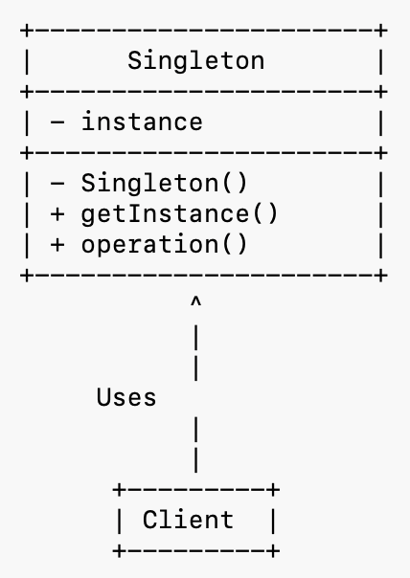
Big Data Analytics and Database Design
Singleton Pattern – Class Diagram

Slide 8


Big Data Analytics and Database Design
Example: Logger
Suppose an application needs a single logger.
Without Singleton
Multiple loggers may write inconsistently.
With Singleton
All classes share:

Slide 9
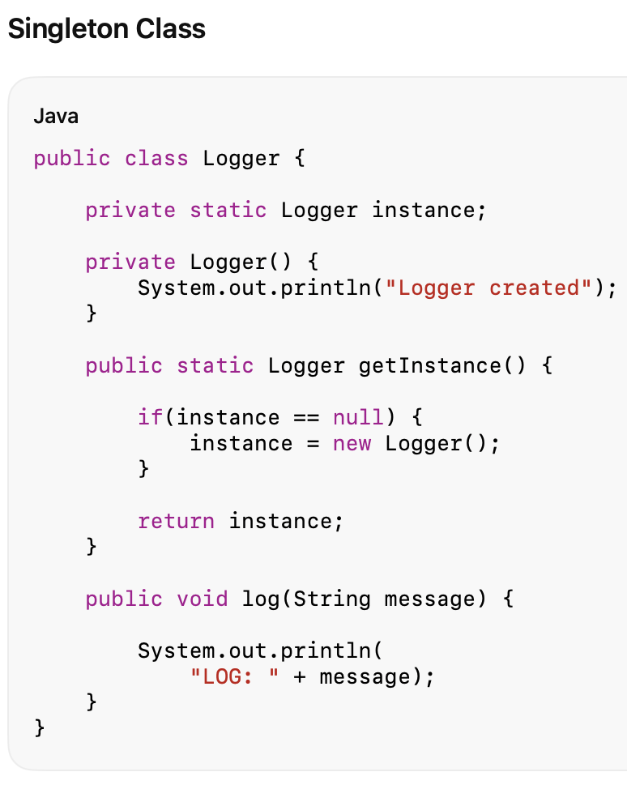
Big Data Analytics and Database Design
Java Code

Slide 10
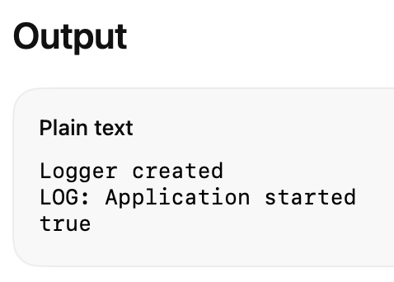
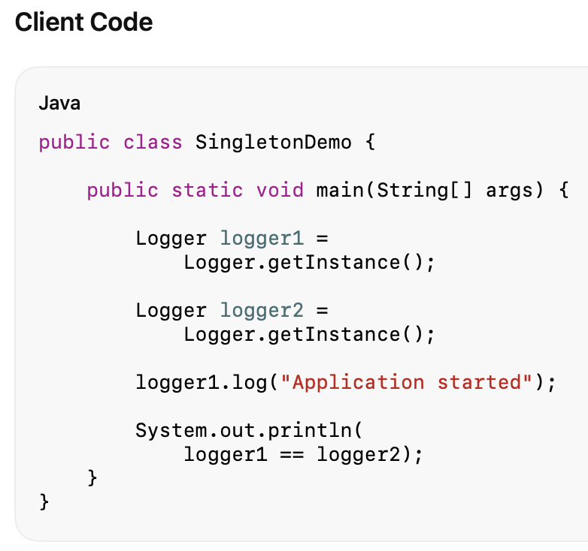
Big Data Analytics and Database Design
Java Code
Notice:
Logger created
appears only once.
Only one object was created.

Slide 11
Big Data Analytics and Database Design
How It Works
Step 1
The first call:
Logger.getInstance();
finds:
instance == null
Step 2
A new object is created:
instance = new Logger();
Step 3
The instance is stored.
Step 4
Future calls:
Logger.getInstance();
return the existing object.
No new objects are created.

Slide 12
Big Data Analytics and Database Design
Java Code
How about Thread-Safe Singleton?

Slide 13
Big Data Analytics and Database Design
Advantages
Controlled Access
Only one instance exists.
Global Availability
Accessible from anywhere.
Saves Memory
Only one object is created.
Consistent State
All clients share the same data.
Useful for Shared Resources
Examples:
Logging
Configuration
Caching
Printing

Slide 14
Big Data Analytics and Database Design
Disadvantages
Global State
Singletons behave similarly to global variables.
This can increase coupling.
Difficult Testing
Mocking and unit testing can become harder.
Hidden Dependencies
Classes may rely on the singleton without explicit dependencies.
Concurrency Issues
Incorrect implementations may create multiple instances in multithreaded systems.
Violates Single Responsibility Principle
The class manages both:
Business functionality
Instance creation and lifecycle

Slide 15
Big Data Analytics and Database Design
When to Use Singleton Pattern
Use Singleton when:
Exactly one instance is required
Examples:
ConfigurationManager
Logger
PrinterManager
Shared access is needed
Many classes must use the same object.
Centralized control is required
One object coordinates a resource.
Global state is acceptable
The application needs a single point of coordination.

Slide 16
Big Data Analytics and Database Design
Key Insight
The Singleton Pattern answers the question:
“How can we guarantee that only one object of a class exists and that everyone uses the same object?”
It does this by:
Making the constructor private.
Storing a single static instance.
Providing a public method (typically getInstance()) to access that instance.

Slide 17
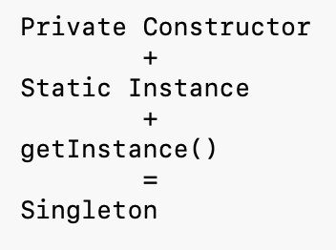
Big Data Analytics and Database Design
Summary
Aspect | Singleton Pattern
Category | Creational
Purpose | Ensure one instance
Main Technique | Private constructor + static instance
Object Creation | Controlled internally
Number of Instances | Exactly one
Common Examples | Logger, Configuration Manager, Printer Manager
Main Advantage | Consistent shared access
Main Disadvantage | Global state and testing challenges

